Slide 1

Bike-sharing target location prediction
Data Analytics for Business

Slide 2
The bike-sharing BOOM
The bike-sharing industry is exploding Offering short-term bicycle rental at urban locations for minimal price
Notes:
The bike-sharing industry is exploding

Slide 3

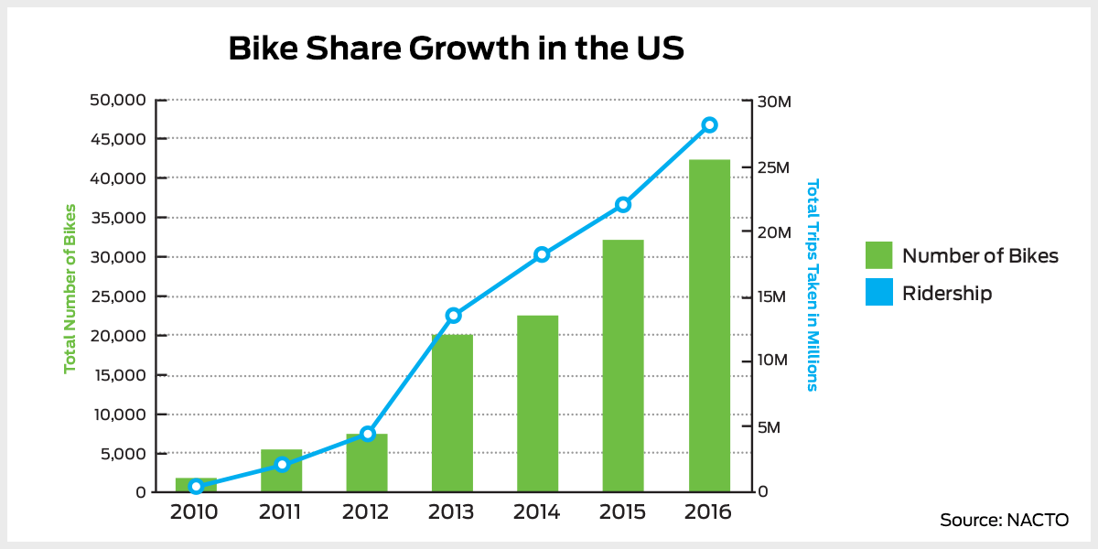
The bike-sharing BOOM
50 million people are regular users !
And in China ?

Slide 4
The bike-sharing BOOM
Millions of users BUT
No company has yet been able to make profit, using only revenues generated from membership subscription or user fees
industry is exploding?
OR
A bubble is about to explode ??

Slide 5

The bike-sharing BOOM
We can feel it ! Can you too ?

Slide 6
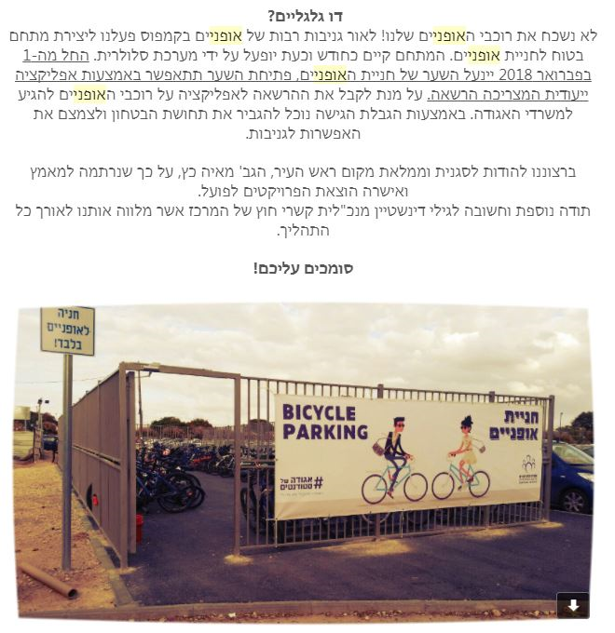


The bike-sharing BOOM
Spotted at Technion

Slide 7


Slide 8

To cut long story short ...

Slide 9


To cut long story short ...
But
KNOWLEDGE
of
FUTURE LOCATION

Slide 10




Who We Are
#datascience
#businessthinker
#materna#cheaf#datascience
Omer Klein
Yarden Israeli
Amitai Serphos

Slide 11
What is our SuperPower ?
Predict DESTINATION
of the next rider to use the bikeshare
Given rental information

Slide 12
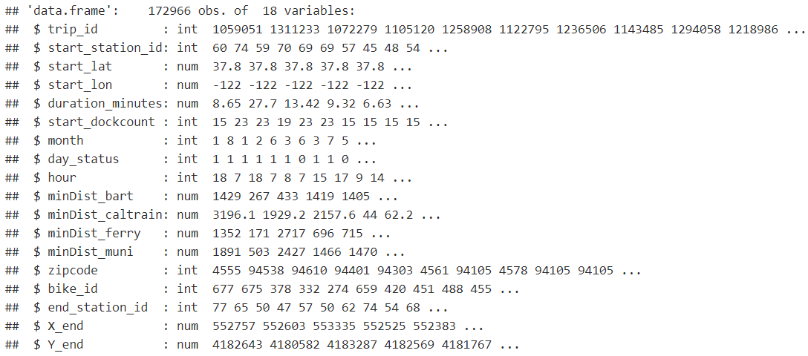
Our DATA

Slide 13

Some inspiration

Slide 14
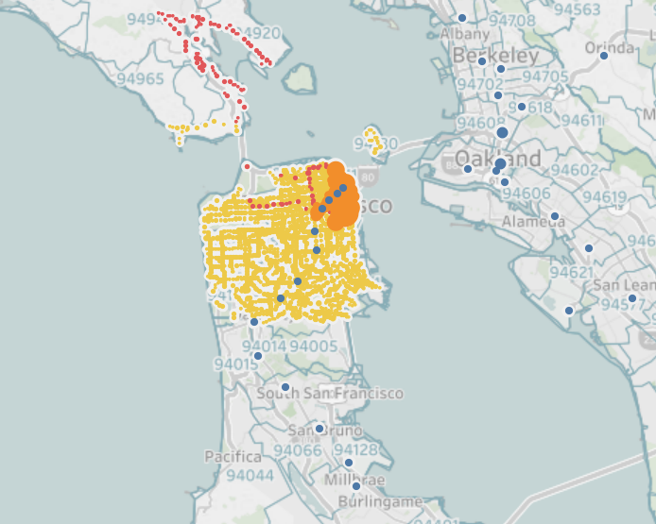

Analyzing the data
Using static maps?!
Station on map overview

Slide 15
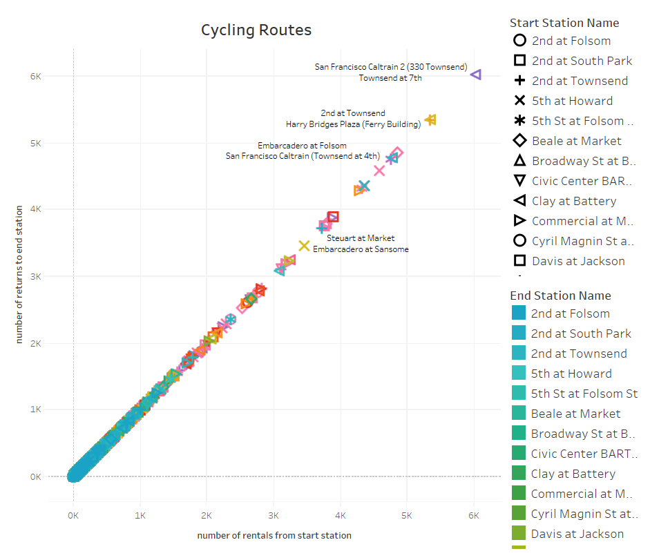

Slide 16
Classical problem of supervised learning

Slide 17
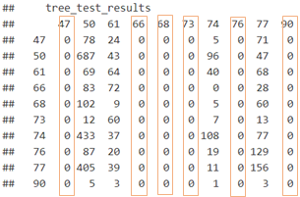
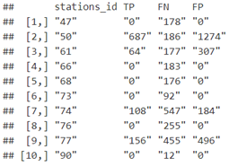
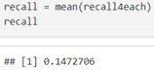

Slide 18
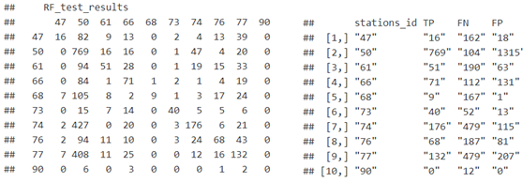
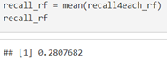

Slide 19
From
classification
to regression

Slide 20
Step 1 regression
Model | Error X | Error Y | Error XY
Comlex Tree | 572.36 m | 806.75 m | 989.16 m
RF | 505.7 m | 713.6 m | 874.6 m
~11%

Slide 21
Step 2 regression
Model | Error XY
Tree | 1130.5 m
MV Tree | 785.9 m
~30%

Slide 22

Notes:
Strength - Algoritem

Slide 23

Destination Based Ad Network
Notes:
Expansion to different cities all around the world

Slide 24


Pre order your coffee

Slide 25

WAZE who?!

Slide 27

Thank you

